Slide 1
Workshop on
Legal Startups
Dr. Kalpeshkumar L Gupta
Associate Professor of Law
Parul Institute of Law, Faculty of Law
Parul University
July 9, 2019

Slide 2
What do you want to do after your law?
Advocate
Judge
Law Teacher
Legal Officer
Consultant
Legalpreneur i.e. starting Legal Startups

Slide 3
Points to be pondered upon
What do you mean by startup?
Why startup needed?
Why startup succeed?

Slide 4
Startups
#A startup is a young company that is just beginning to develop.*
#Startups are usually small and initially financed and operated by a handful of founders or one individual. These companies offer a product or service that is not currently being offered elsewhere in the market, or that the founders believe is being offered in an inferior manner.*
#Startups are entrepreneurial ventures and new businesses focused on searching for a repeatable and scalable business model.**
#Startups are focused on rapid growth and the potential for substantial future revenue.**
*https://www.investopedia.com/ask/answers/12/what-is-a-startup.asp
**https://digitalcommons.law.msu.edu/cgi/viewcontent.cgi?article=1540&context=facpubs

Slide 5
Startups
A startup is a company working to solve a problem where the solution is not obvious and success is not guaranteed.
- Neil Blumenthal, cofounder and co-CEO of Warby Parker

Slide 6
The campaign was first announced by Indian Prime Minister, Narendra Modi during his 15 August 2015 address from the Red Fort, in New Delhi.
The action plan of this initiative, is based on the following three pillars:
1. Simplification and Handholding.
2. Funding Support and Incentives.
3. Industry-Academia Partnership and Incubation.
Cont…

Slide 7
Gujarat best state in providing strong ecosystem for startups: Dept of Industrial Policy & Promotion ranking
2018 Startup State Ranking are as follows:
Best performer: Gujarat
Top performers: Karnataka, Kerala, Odisha, and Rajasthan
Leader: Andhra Pradesh, Bihar, Chhattisgarh, Madhya Pradesh, and Telangana
Aspiring leaders: Haryana, Himachal Pradesh, Jharkhand, Uttar Pradesh, and West Bengal
Emerging states: Assam, Delhi, Goa, Jammu & Kashmir, Maharashtra, Punjab, Tamil Nadu, and Uttarakhand
Beginners: Chandigarh, Manipur, Mizoram, Nagaland, Puducherry, Sikkim, and Tripura
https://economictimes.indiatimes.com/small-biz/startups/newsbuzz/gujarat-best-state-in-providing-strong-ecosystem-for-startups-dipp-ranking/articleshow/67176184.cms

Slide 8
MINISTRY OF COMMERCE AND INDUSTRY (Department of Industrial Policy and Promotion) NOTIFICATION New Delhi, the 11th April, 2018
An entity shall be considered as a Startup:
i. Upto a period of 7 years from the date of incorporation/registration,
if it is incorporated as a private limited company (as defined in the Companies Act, 2013) or registered as a partnership firm (registered under section 59 of the Partnership Act, 1932) or a limited liability partnership (under the Limited Liability Partnership Act, 2008) in India.
In the case of Startups in the biotechnology sector, the period shall be upto 10 years from the date of its incorporation/ registration.
ii. Turnover of the entity for any of the financial years since incorporation/ registration has not exceeded Rs. 25 crore
iii. Entity is working towards innovation, development or improvement of products or processes or services, or if it is a scalable business model with a high potential of employment generation or wealth creation.
Cont…
https://dipp.gov.in/sites/default/files/Startup_Notification11April2018_0.pdf

Slide 9
Cont…
MINISTRY OF COMMERCE AND INDUSTRY (Department of Industrial Policy and Promotion) NOTIFICATION New Delhi, the 11th April, 2018
Provided that an entity formed by splitting up or reconstruction of an existing business shall not be considered a ‘Startup’.
Explanation
An entity shall cease to be a Startup on completion of 7 years from the date of its incorporation/ registration or if its turnover for any previous year exceeds Rupees 25 crore.
In respect of Startups in the biotechnology sector, an entity shall cease to be a Startup on completion of 10 years from the date of its incorporation/ registration or if its turnover for any previous year exceeds Rs. 25 crore.
https://dipp.gov.in/sites/default/files/Startup_Notification11April2018_0.pdf

Slide 10
90% Of Indian Startups Will Fail Because Of Lack Of Innovation, Study Says
Of late, India might have become the third-largest startup ecosystem, but it lacks successful innovation.
Notwithstanding the fact that market valuation of Indian startups has grown significantly over the past four years, a recent study, “Entrepreneurial India,” by the IBM Institute for Business Value and Oxford Economics found that 90% of Indian startups fail within the first five years. And the most common reason for failure is lack of innovation.
77% of venture capitalists surveyed believe that Indian startups lack new technologies or unique business models
https://www.forbes.com/sites/suparnadutt/2017/05/18/startups-in-india-fail-due-lack-of-innovation-according-to-a-new-ibm-study/#201e3c89657b

Slide 11
90% Of Indian Startups Will Fail Because Of Lack Of Innovation, Study Says
It's well known that most Indian startups are prone to emulate successful global ideas, by and large fine-tuning an existing model to serve local needs.
https://www.forbes.com/sites/suparnadutt/2017/05/18/startups-in-india-fail-due-lack-of-innovation-according-to-a-new-ibm-study/#201e3c89657b

Slide 12
Legal Startups
A legal start-up is a newly formed organization providing innovative products or services to improve legal service delivery.
"Innovative" is applied broadly to include innovative products and services or innovation in legal service delivery.
Excluded from this definition, at least for our purposes, are consultants and law firms
**https://digitalcommons.law.msu.edu/cgi/viewcontent.cgi?article=1540&context=facpubs

Slide 13
Segment served by Legal Startups
B2C
B2B
B2G
B2L
**https://digitalcommons.law.msu.edu/cgi/viewcontent.cgi?article=1540&context=facpubs

Slide 14
Segment served by Legal Startups
1. B2C
Find a Lawyer
Do It Yourself (Legal Documents)
Online legal aid
Free Legal
**https://digitalcommons.law.msu.edu/cgi/viewcontent.cgi?article=1540&context=facpubs

Slide 15
Segment served by Legal Startups
2. B2B
Find a Lawyer
Managing Legal Supply Chain
Legal Process Outsourcing (LPO)
Compliance
Contract Management
**https://digitalcommons.law.msu.edu/cgi/viewcontent.cgi?article=1540&context=facpubs

Slide 16
Segment served by Legal Startups
3. B2G
Online Dispute Resolution
Software, App etc for Judiciary
**https://digitalcommons.law.msu.edu/cgi/viewcontent.cgi?article=1540&context=facpubs

Slide 17
Segment served by Legal Startups
4. B2L
Lawyer to Lawyer Networking
Legal Research
Analytics
Legal Education Training
Client Case Management platform
**https://digitalcommons.law.msu.edu/cgi/viewcontent.cgi?article=1540&context=facpubs

Slide 18
Legal Startups
Legal Intern
ADR India
Superlawyer

Slide 19
http://legalstartups.info/
Founder :- Dr. Kalpeshkumar L Gupta
November 2018

Slide 20
GNLU Legal Incubation Council (Sec. 8 Company)
IncMent
E-Cell
Research
IncMent - Incubation & Mentorship, it will incubate and mentor the startups.
E-Cell - Inculcate and promote culture of entrepreneurship by way of forming Entrepreneurship Cell, consisting of law and management students of the university.
Research - On entrepreneurship and allied aspects

Slide 21
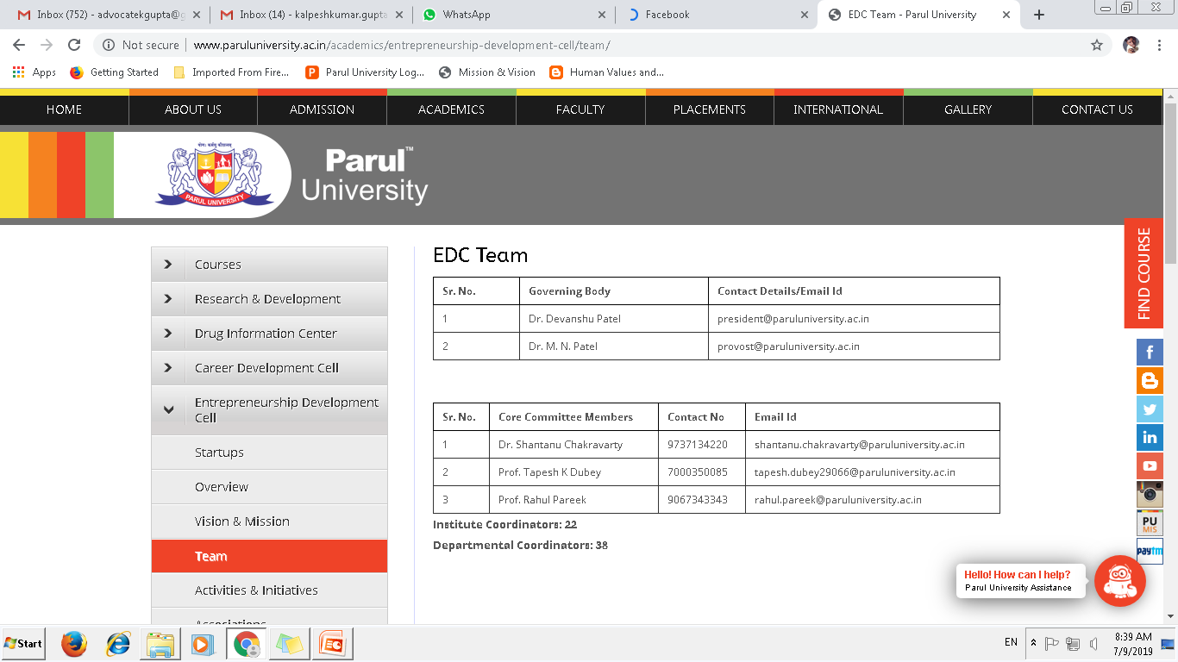

Slide 22
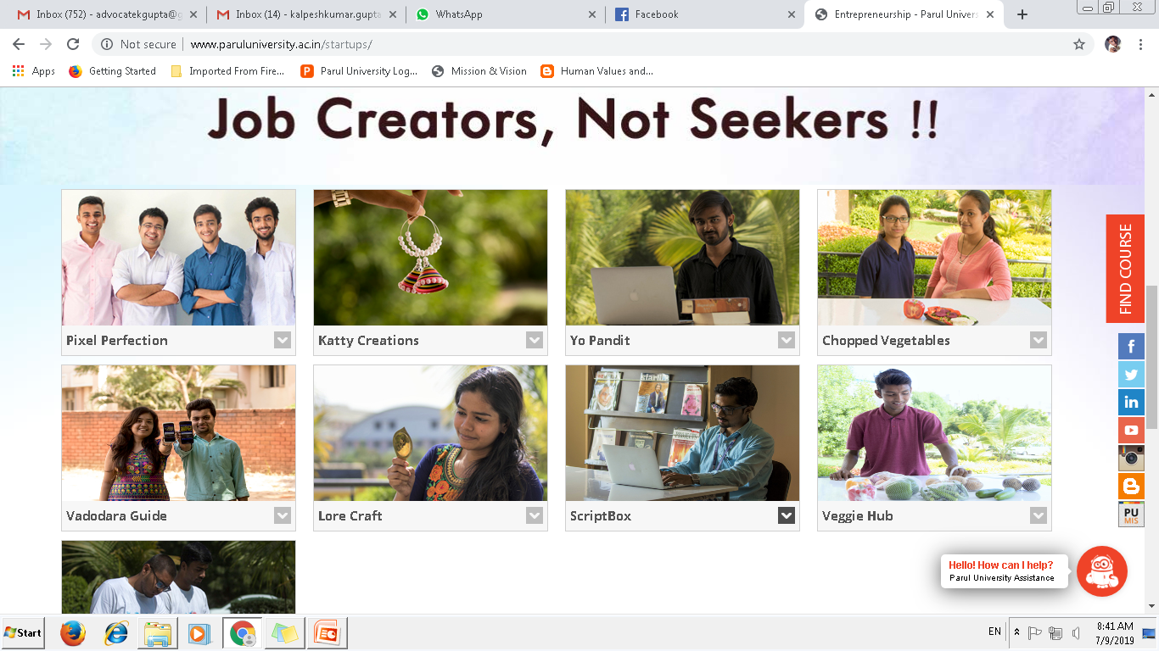

Slide 23
Group Exercise

Slide 24
Dr. Kalpeshkumar L Gupta
www.klgupta.in

